Slide 1
Chapter 2: Intro to Relational Algebra

Slide 2
DBMS Architecture
How does a SQL engine work ?
SQL query → relational algebra plan
Relational algebra plan → Optimized plan
Execute each operator of the plan

Slide 3
Relational Algebra
Five operators:
  Union
  Difference
  Selection
  Projection
  Cartesian Product
Derived or auxiliary operators:
  Intersection
  Joins (natural,equi-join, theta join, semi-join)
  Renaming

Slide 4

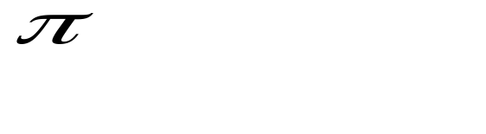
Relational Algebra: 5 Basic Operations
Selection ( ) Selects a subset of rows from relation (horizontal).
Projection ( ) Retains only wanted columns from relation (vertical).
Cross-product (x) Allows us to combine two relations.
Set-difference (–) Tuples in r1, but not in r2.
Union (∪ ) Tuples in r1 and/or in r2.

Slide 5
Selection (σ)
Selects rows that satisfy selection condition.
Result is a relation.- Schema of result is same as that of the input relation.
Notation: σ_{c}(R) The condition c can be =, <, ≤, >, ≥, <>

Slide 6
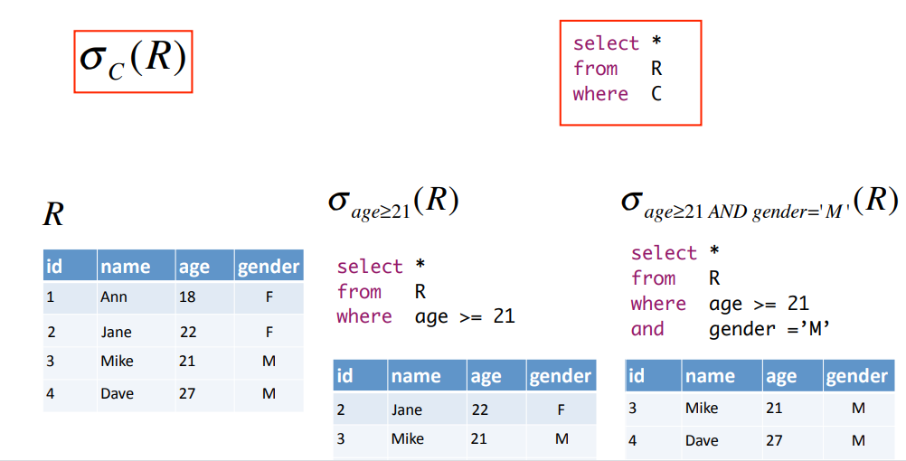
Selection

Slide 7
2. Projection
Eliminates columns, then removes duplicates
Notation: P _{A1,…,An} (R)
Example: project social-security number and names:
  P _{SSN, Name} (Employee)
  Output schema: Answer(SSN, Name)

Slide 8
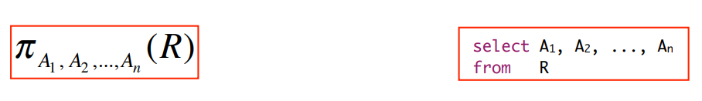
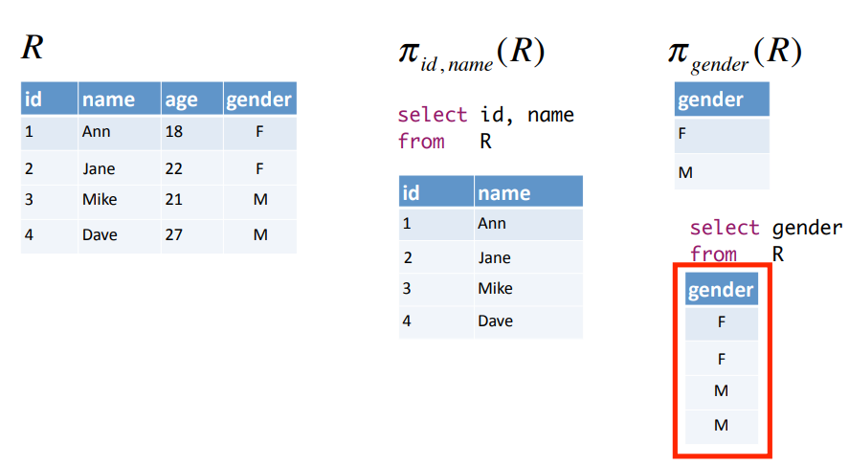
Projection

Slide 9
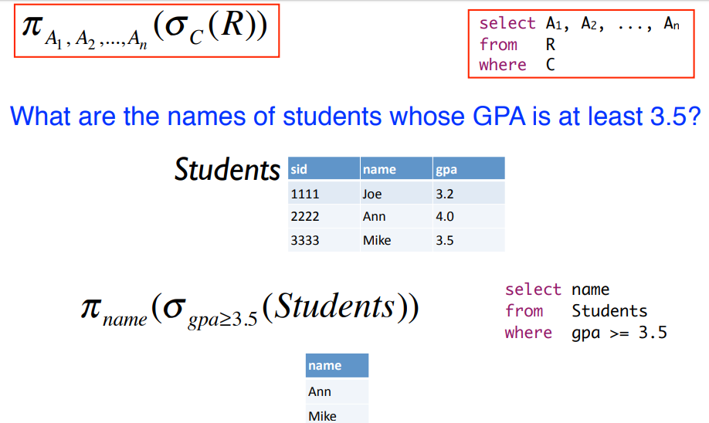
Combining selection and projection

Slide 10
3. Cartesian Product
Each tuple in R1 with each tuple in R2
Notation: R1 × R2
Example:
  Employee × Dependents
Very rare in practice; mainly used to express joins

Slide 11
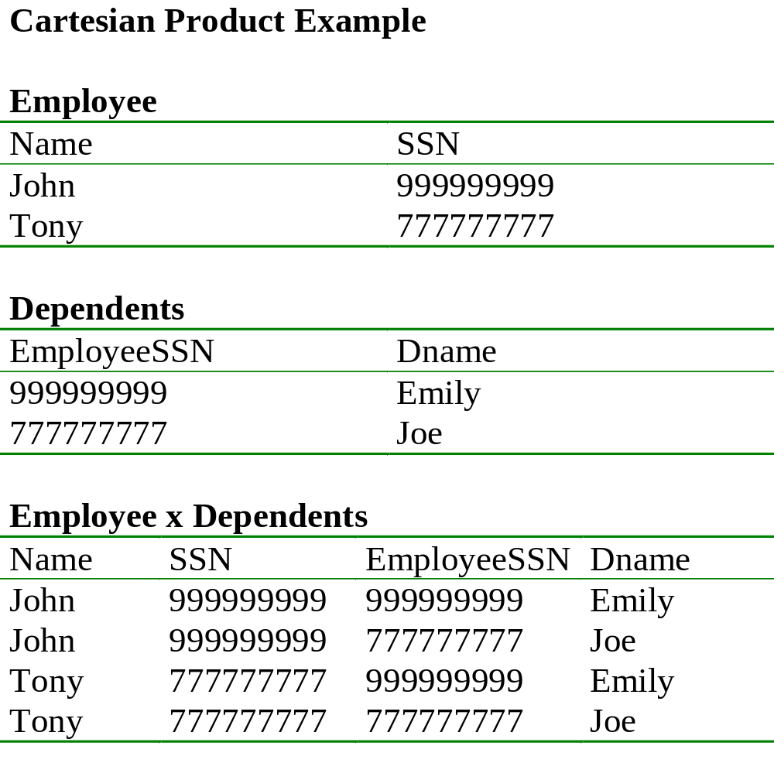

Slide 12
4. Union and 5. Difference
All of these operations take two input relations, which must be union-compatible:
  Same number of fields.
  `Corresponding’ fields have the same type.
Union eliminates duplicates
R1 ∪ R2
  ActiveEmployees ∪ RetiredEmployees
R1 – R2
  AllEmployees -- RetiredEmployees

Slide 13
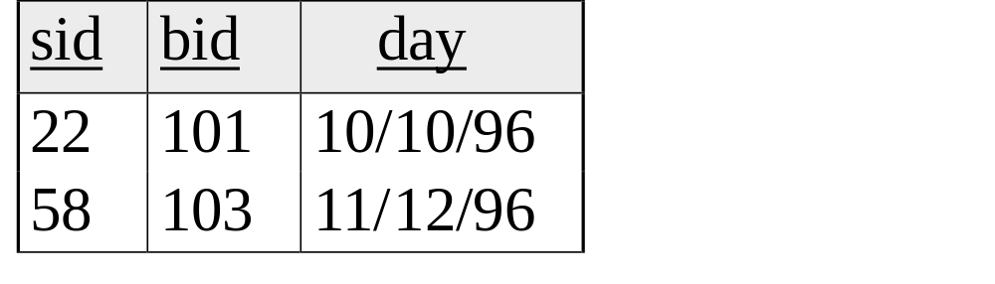
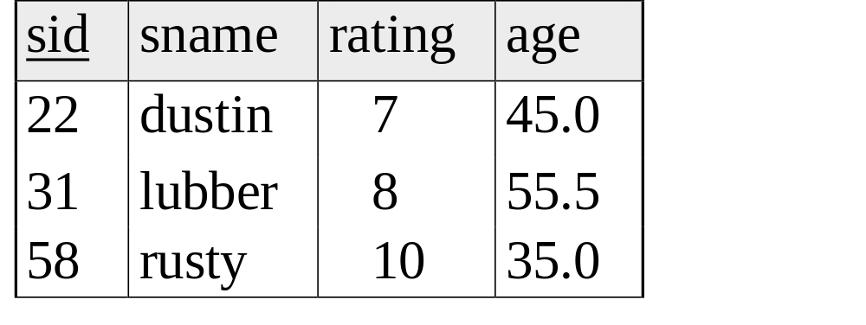
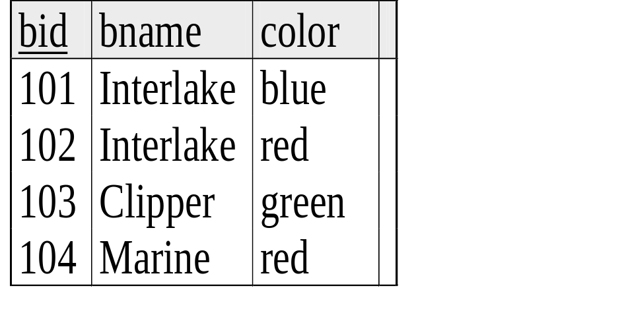
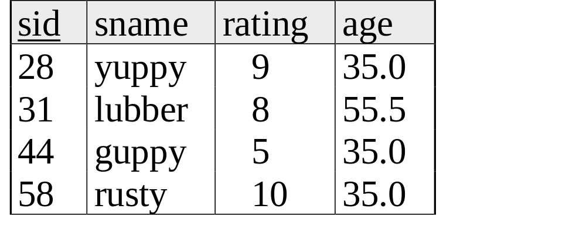
Example Instances
Reserves
Sailor1
Sailor2
Boats

Slide 14
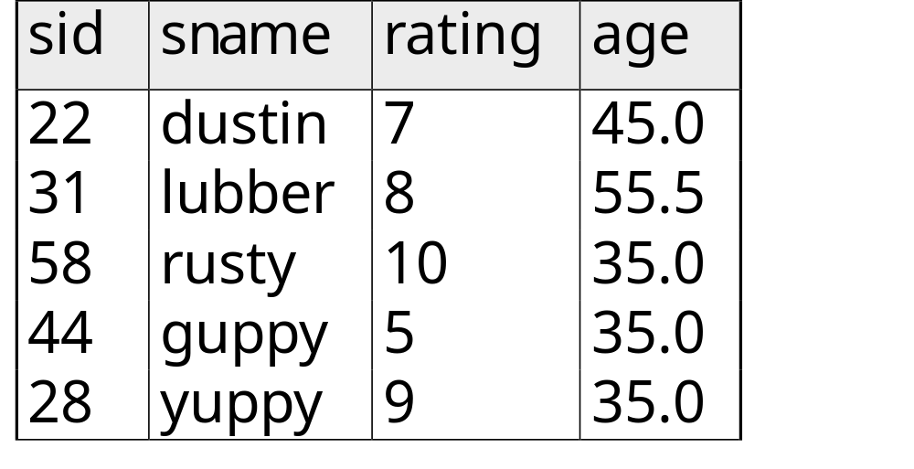
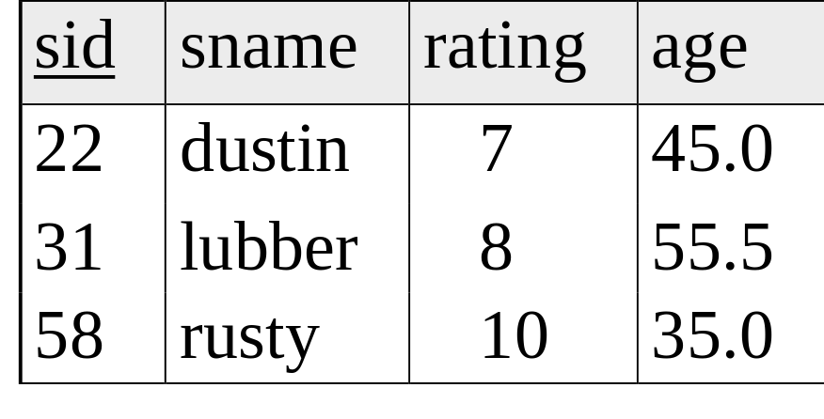
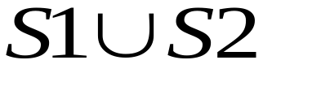
Union
S1
S2

Slide 15
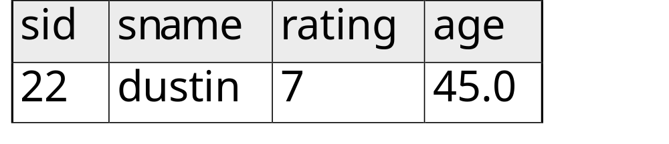

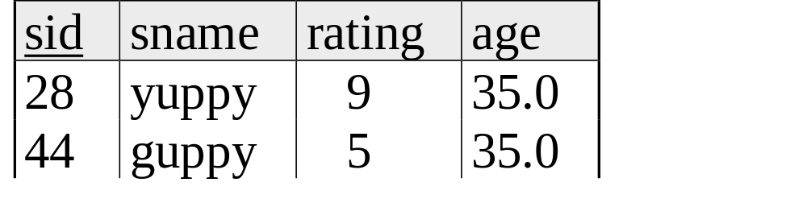
Set Difference
S1
S2 – S1
S2

Slide 16
Intersection
In addition to the 5 basic operators, there are several additional “Compound Operators”
  These add no computational power to the language, but are useful shorthands.
  Can be expressed solely with the basic ops.
Intersection takes two input relations, which must be union-compatible.
Q: How to express it using basic operators?
R ∩ S = R − (R − S)

Slide 17
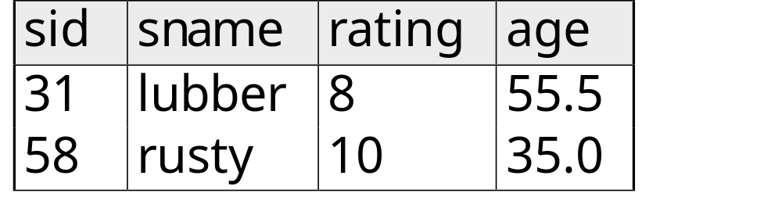
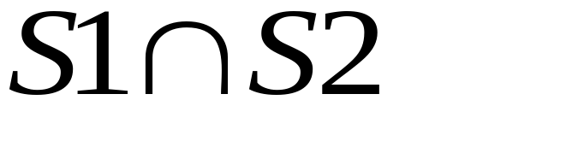
Intersection
S1
S2

Slide 18
Renaming
Changes the schema, not the instance
Notation: ρ _{x(B1,…,Bn)} (R)
Example:
  ρ _{Εmp(LastName, SsnNo)} (Employee)
  Output schema:
  Emp(LastName, SsnNo)
  https://www.youtube.com/watch?v=AiHBCgZnnpk

Slide 19
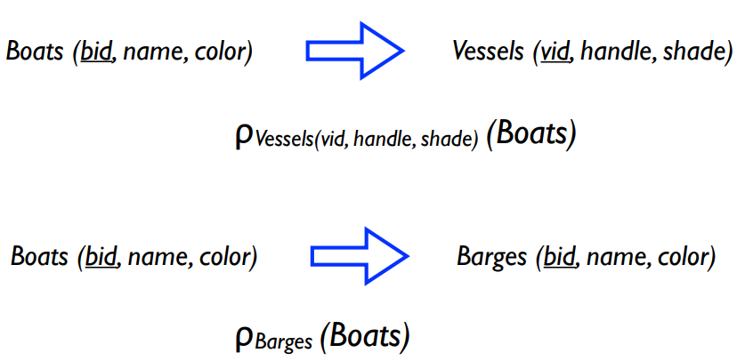
Syntax
Renaming relation and attributes

Slide 20
Join
An SQL JOIN clause is used to combine rows from two or more tables, based on a common field between them.
Joins are compound operators involving cross product, selection, and (sometimes) projection

Slide 21
Natural Join
Most common type of join is a “natural join Notation: R1 R2
Meaning: R1 R2 = π_{A}(σ_{C}(R1 × R2))
Where:
  The selection s_{C} checks equality of all common attributes
  The projection eliminates the duplicate common attributes
  Steps:
  Compute R X S
  Select rows where attributes that appear in both relations have equal values
  Project all unique attributes and one copy of each of the common ones.

Slide 22
Natural Join Example
Employee
Name
SSN
John
999999999
Tony
777777777
Dependents
SSN
Dname
999999999
Emily
777777777
Joe
Employee Dependents =
Π_{Name, SSN, Dname}(σ _{SSN=SSN2}(Employee x ρ_{SSN2, Dname}(Dependents))
Name
SSN
Dname
John
999999999
Emily
Tony
777777777
Joe

Slide 23
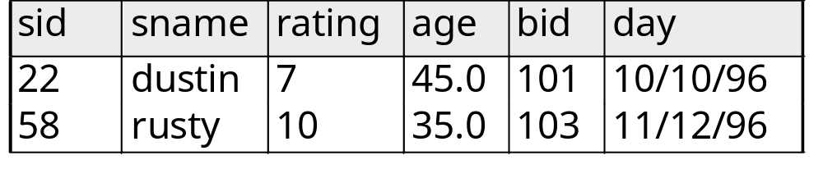
Natural Join Example
R1
S1
R1 S1 =

Slide 24
Theta Join
A join that involves a predicate
R1 _{q} R2 = σ _{q} (R1 × R2)
Here q can be any condition <,>,<=,>=,=

Slide 25
Eq-join
A theta join where q is an equality
R1 _{A=B} R2 = σ _{A=B} (R1 × R2)
Example:
  Employee _{SSN=SSN} Dependents
Most useful join in practice

Slide 26
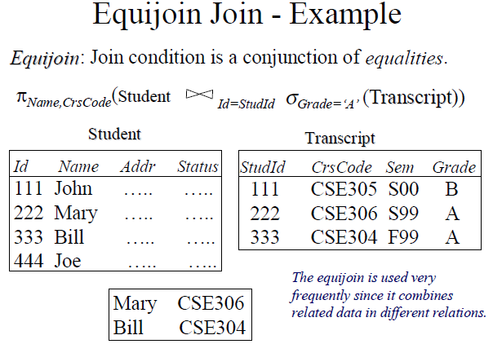

Slide 27
Practice questions

Slide 28
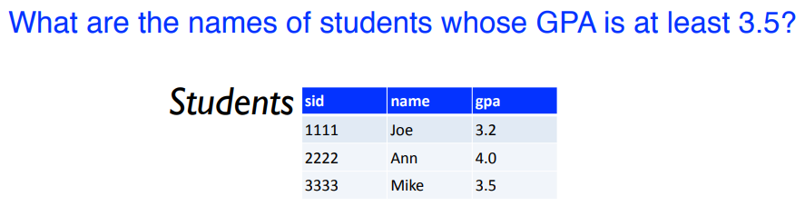
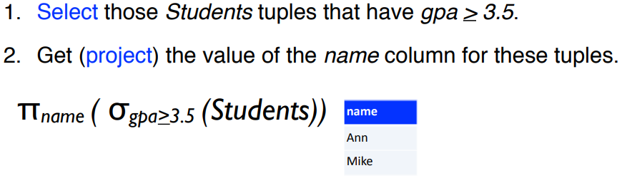

Slide 29
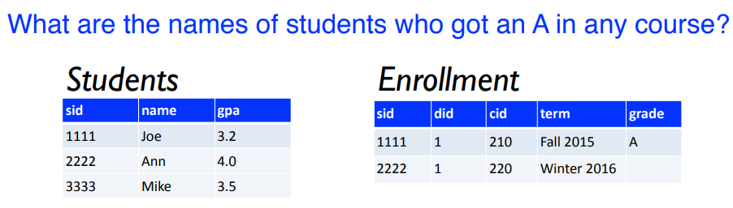
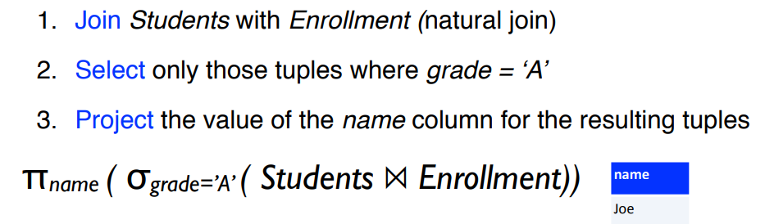

Slide 30
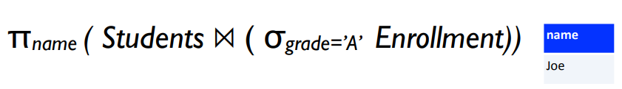

Slide 31
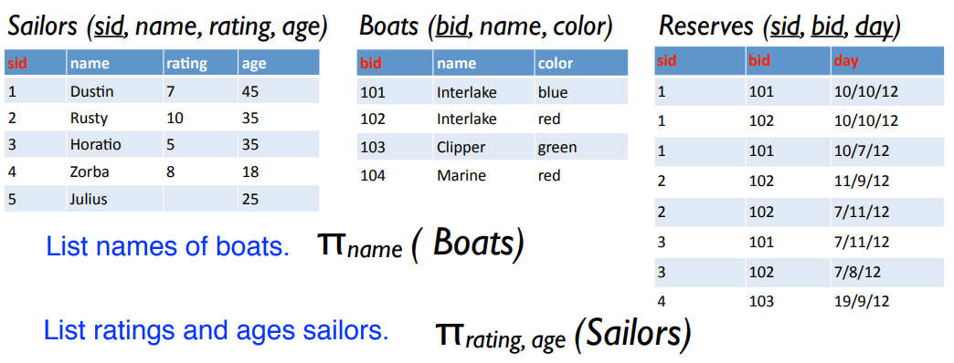

Slide 32
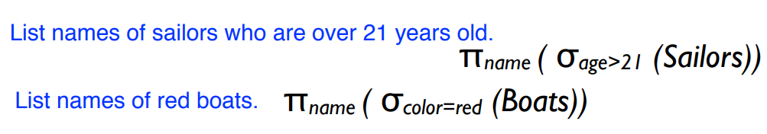
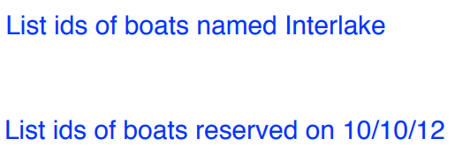

Slide 33
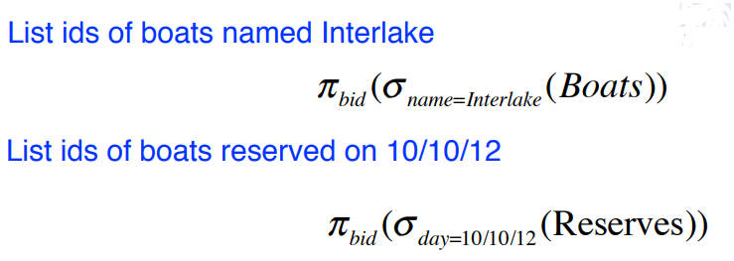
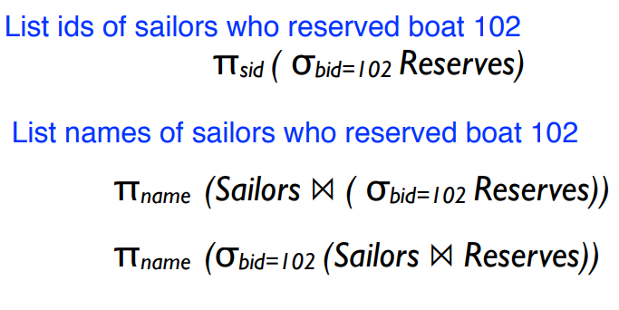

Slide 34
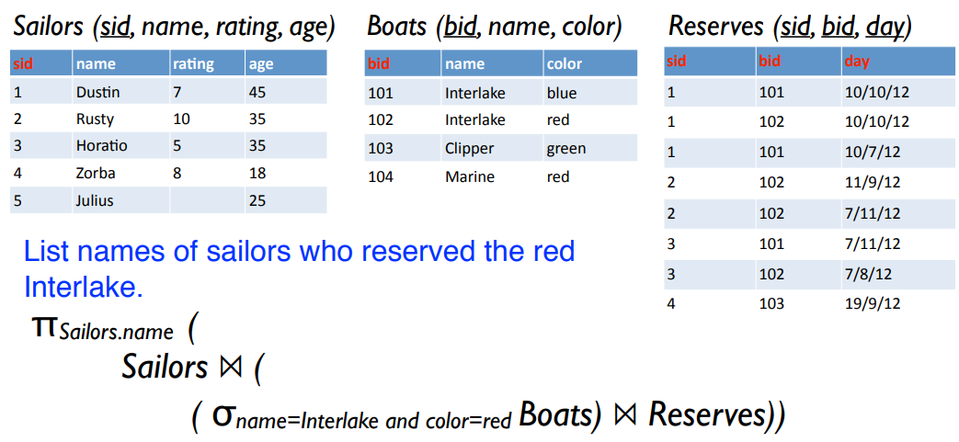
Query involving 3 relations

